Slide 1
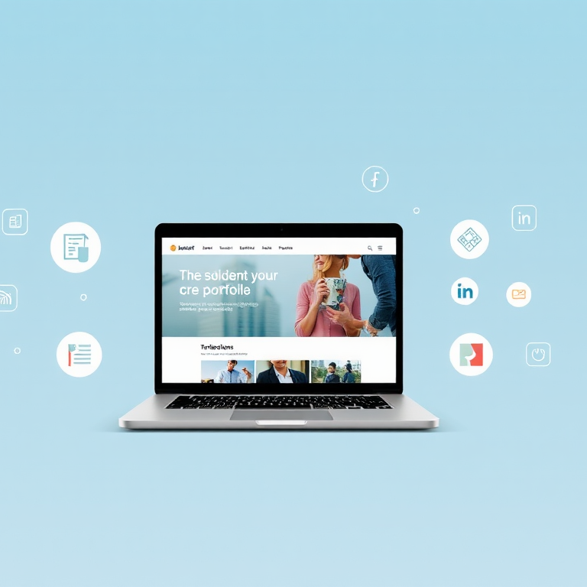
CAREER ESSENTIAL: Building Your Portfolio Website
Presented by
Favour James

Slide 2



INTRODUCTION
Personal Branding is crucial for achieving career success, as it shapes your self-presentation and affects how others view your professional identity.
To build a strong personal brand, you need three essential components.
A Well-Crafted Resume
A Strong LinkedIn Profile
A Portfolio Website

Slide 3

What is a Portfolio Website?
A portfolio is a compilation of your notable work that showcases your skills and abilities. It can either be physical or digital.
You can include a link to your portfolio on your resume and/or job application, or you can provide it during a first interview or meeting with the employer or client to demonstrate the kind of work you are capable of.
A portfolio website is an online platform where you can present your portfolio in a visually appealing and organized manner. A good portfolio website should tell a story. Your Story!

Slide 4

Let’s Conduct a Quick Poll
www.menti.com
Access Code: 28410867

Slide 5


Importance of a Portfolio Website
Demonstrate your skills, projects, and achievements in one centralized location.
Attract ideal clients and reach a global audience.
Convey that you are serious about what you do and committed to showcasing your work in the best possible way.
Motivate you to be innovative and produce higher-quality work.
Lead to valuable feedback that helps you identify areas for improvement and growth.

Slide 6




Elements of a Portfolio Website
Essential Components:
Home Page: Brief introduction and overview.
About Me: Your background, top skills, and professional journey.
Projects: Showcase your best work with descriptions.
Contact Information: Include an email address or a contact form to reach you.
Other Components:
Testimonials/Recommendations: Positive feedback from clients
Resume/CV: A downloadable version of your resume or CV
Service/Expertise: A list of the specific services you offer or your areas of expertise

Slide 7
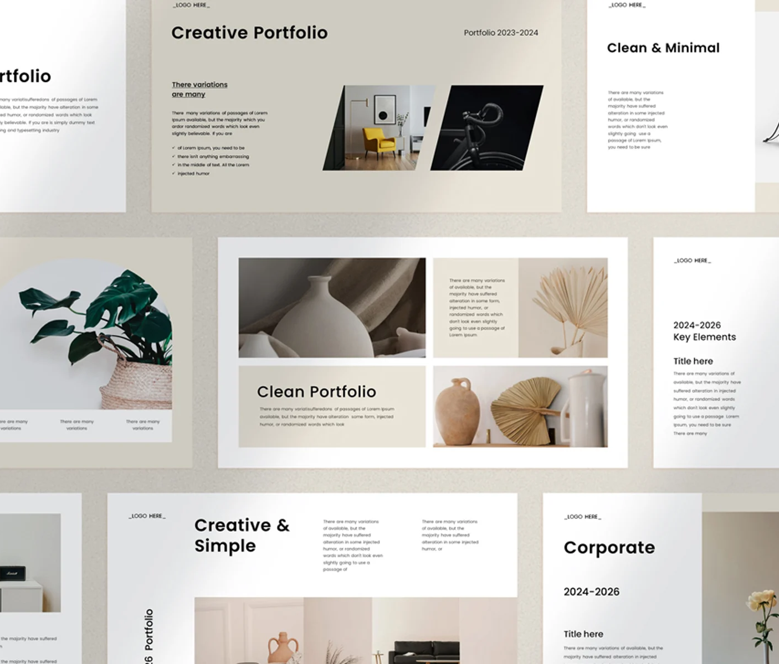






Designing Your Portfolio Website
Visually engaging and user-friendly.
Use consistent branding (colors, fonts).
Reflect your personality and communicate the result of your work.
Ensure mobile responsiveness.
Regularly updated with new projects and achievements

Slide 8










Different Platforms to Showcase Your Portfolio

Slide 9

CONCLUSION
Having an online portfolio is an incredible opportunity to showcase your best work to the world in your own unique way. It can reinforce your professional identity and help you establish yourself as a skilled person in your field.
A good portfolio is not only a showcase of your work; it is a compelling storytelling tool that allows you to show who you are and present your journey, skills, and passion.

Slide 10

PRACTICAL
Build your portfolio today!

Slide 11




We will be leveraging GitHub to store projects and for website hosting.
GitHub is an invaluable platform for developers and creatives alike, enabling you to store your projects, collaborate with others, and showcase your work to potential employers.
A collection of free, responsive website templates that make it easy to create a professional-looking portfolio.
A powerful and user-friendly code editor with features like syntax highlighting, debugging, and extensions to enhance your development experience.

Slide 12
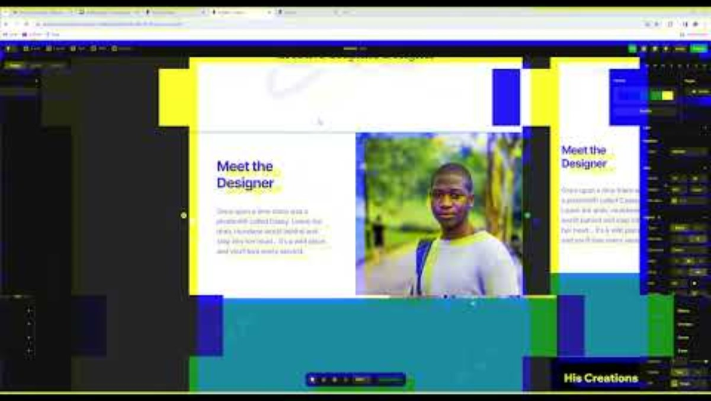
Build Your Website with AI
In this 21-minute video, you will learn how to build a portfolio website using Framer, which will contain your bio, portfolio, and contact information.

Slide 13


